Slide 1


Buda Tech
RESISTANCE & RESISTIVITY
$$R=\frac{ρ×L}{A}$$
R is Resistance
A Area
$ρ$ R$esistivity of material$
L Length of a conductor

Slide 2
Buda Tech
Resistance R; unit, ohm ( Ω )
This is the opposition to the flow of current in a circuit.
Resistance
e
e
Voltage
e
e
e
Current direction

Slide 3
Buda Tech
Resistivity: symbol, ρ ; unit, Ω mm
It's a measure of how much a material resists the movement of electrical charge.
Lower resistivity indicates a material that readily allows current to flow.
Let's take a sample of material in the form of a cube of side 1 mm and measure the resistance between opposite faces. The resulting value is called the resistivity of that material.
1mm
Ω

Slide 4

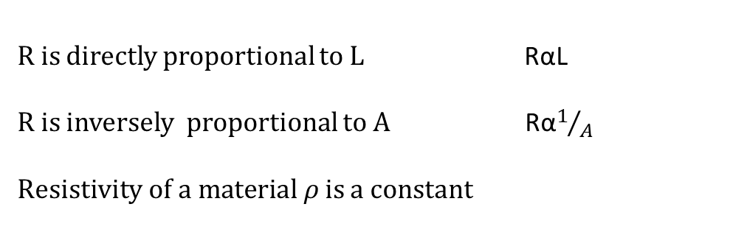
Buda Tech
Length
Area
$ρ$ Resistivity
R is directly proportional to L RαL
R is inversely proportional to A Rα$1/A$
R$esistivity of a material ρ$ is a constant
$$R=\frac{ρ×L}{A}$$

Slide 5


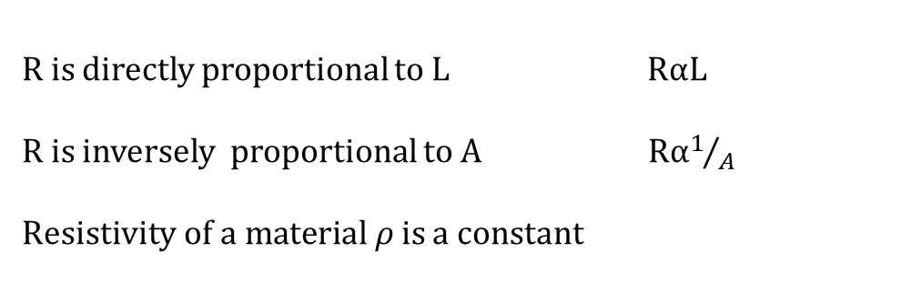
LENGTH
Buda Tech
Length
A
$ρ$ Resistivity
B
$ρ$ Resistivity
Resistance of conductor A > Resistance of conductor B
R is directly proportional to L RαL
R is inversely proportional to A Rα$1/A$
R$esistivity of a material ρ$ is a constant
$$R=\frac{ρ×L}{A}$$

Slide 6


AREA
Buda Tech
Length
A
$ρ$ Resistivity
Large cross section area
B
$ρ$ Resistivity
Small cross section area
Resistance of conductor B > Resistance of conductor A
R is directly proportional to L RαL
R is inversely proportional to A Rα$1/A$
R$esistivity of a material ρ$ is a constant
$$R=\frac{ρ×L}{A}$$

Slide 7
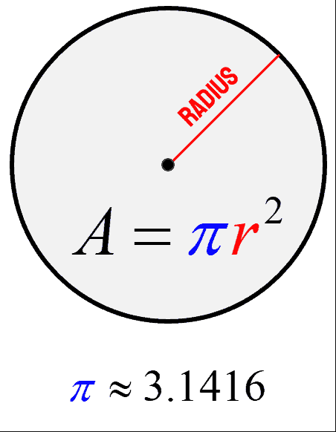
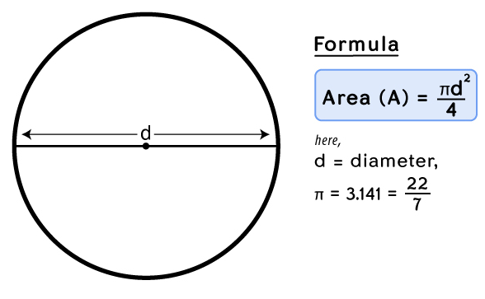
AREA
Buda Tech

Slide 8
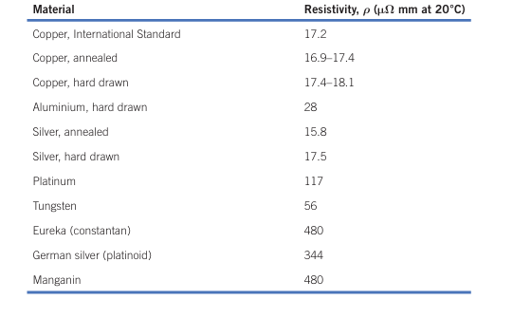
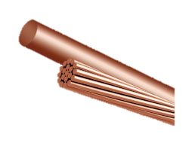
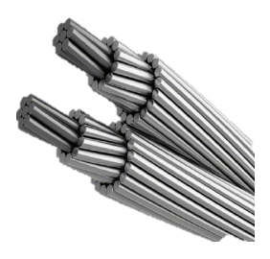
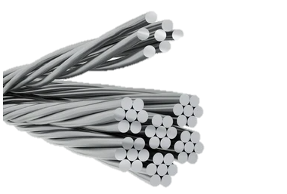
Buda Tech
Copper
Aluminum
Silver

Slide 9


Buda Tech
Examples
Calculate the resistance of a 50 m length of copper conductor of cross section area 2.5 m$m^{2}$, if the resistivity of the copper used is 17.6 μ Ω mm.
50 m
17.6 μ Ω mm
2.5 m$m^{2}$
$$R=\frac{ρ×L}{A}$$
$R=\frac{17.6×{10}^{−6} x 50 x{10}^{3}}{2.5}$
$R=\frac{17.6×{10}^{−6+3} x 50 }{2.5}$
$R=17.6×{10}^{−3} x 20$
$R=352×{10}^{−3}$Ω
$R=0.352$Ω

Slide 10


Buda Tech
Examples
Calculate the resistivity of aluminum if a 100 m length of conductor cross-section area 4 m$m^{2}$has a measured resistance of 0.7 Ω .
100 m
μ Ω mm
4m$m^{2}$
$$ρ=\frac{R×A}{L}$$
$ρ =\frac{0.7x 4}{100×{10}^{3}}$
$$ρ=\frac{2.8}{100000}$$
$ρ =2.8×{10}^{−5}$
$$ρ =28\text{μ} \text{Ω} \text{mm}$$

Slide 11


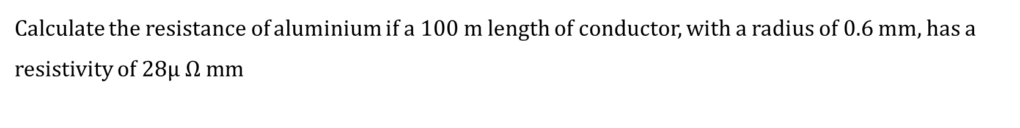



Buda Tech
Examples
Calculate the resistance of aluminium if a 100 m length of conductor, with a radius of 0.6 mm, has a resistivity of $28\text{μ} \text{Ω} \text{mm}$
100 m
R = 0.6m
$A=πr^{2}$
28μ Ω mm
$$A=3.14 x {0.6}^{2}$$
$$R=\frac{ρ×L}{A}$$
$R=\frac{28 ×{10}^{−6} x 100 x{10}^{3}}{1.13}$
$R=\frac{28×{10}^{−6+3+2} x 1 }{1.13}$ = $\frac{2.8}{1.13}$
$R=2.478$Ω
$R=2.478$Ω
$$A=1.13{mm}^{2}$$
100 $={10}^{2}$

Slide 12
